Slide 1
Support Vector Machines (SVM)
Jeffrey Hoang, Puribi

Slide 2
What is Machine Learning
Three Categories:
Supervised Learning: when we have data and can train it
Unsupervised Learning: when we are guessing of what we can make sense of the data
Reinforcement Learning: where we reinforce a good or bad behavior
SVM falls under supervised learning, where the machine learning model learns from past input data and makes future predictions as output

Slide 3
What is it?
The objective of the support vector machine is to find a hyperplane in an N-dimensional space that distinctly classifies the data points into two classes
There are many hyperplanes that can be chosen to separate the two classes of data points, however the purpose of the SVM is to find a plane that has the maximum margin (the distance between the support vector and the hyperplane should be as far as possible)

Slide 4
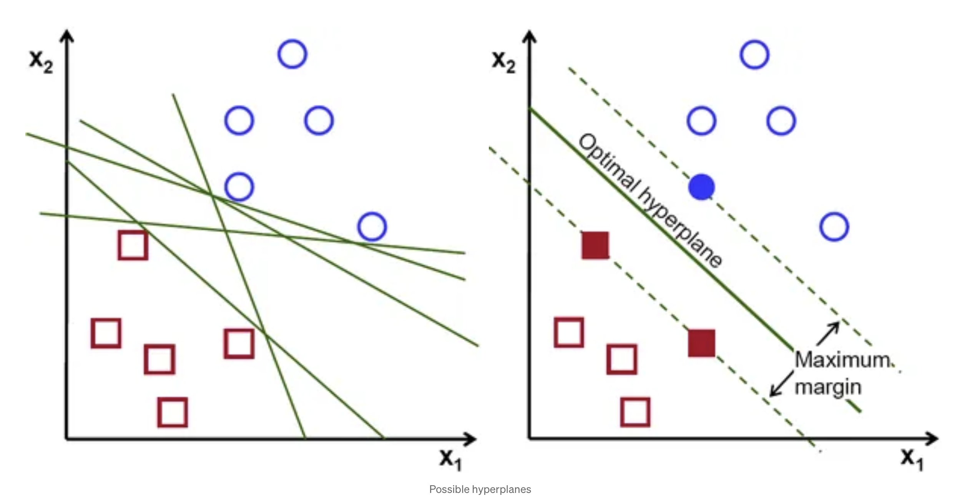
Maximizing the Margin

Slide 5
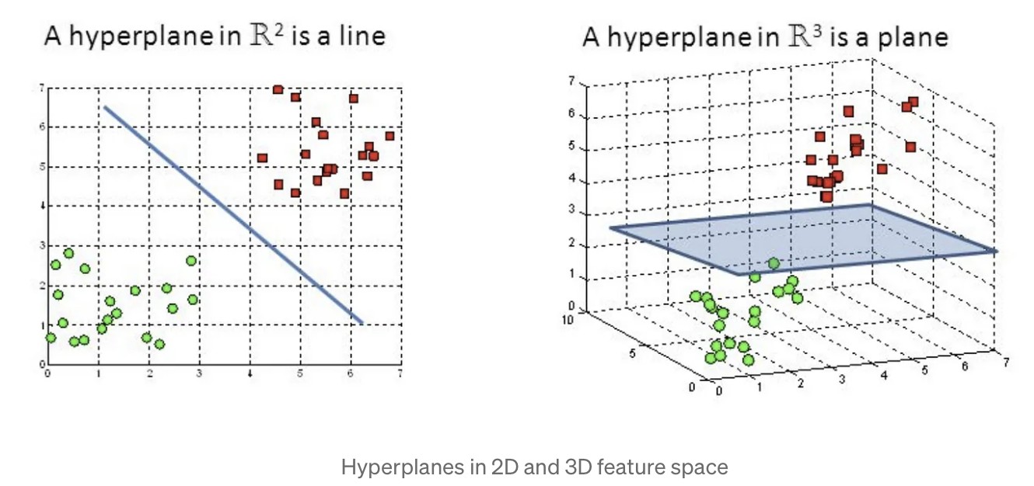
What are Hyperplanes?
Hyperplanes are decision boundaries that help classify the data points. Data points following on separate sides of the hyperplane are considered to be in different classes.
The dimension of the hyperplanes depend on the number of features:

Slide 6
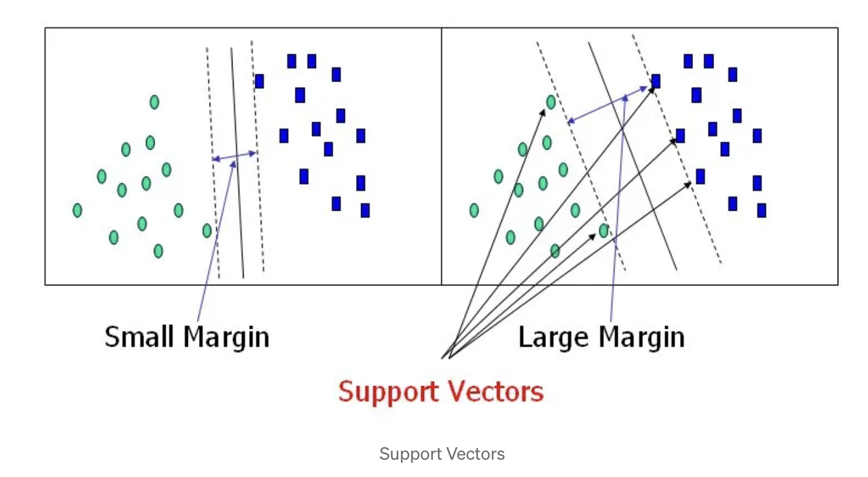
What are Support Vectors
Support vectors are are data points that are closer to the hyperplane and influence its position and orientation.
Support vectors are what helps build our SVM because using them maximizes the margin of the classifier

Slide 7
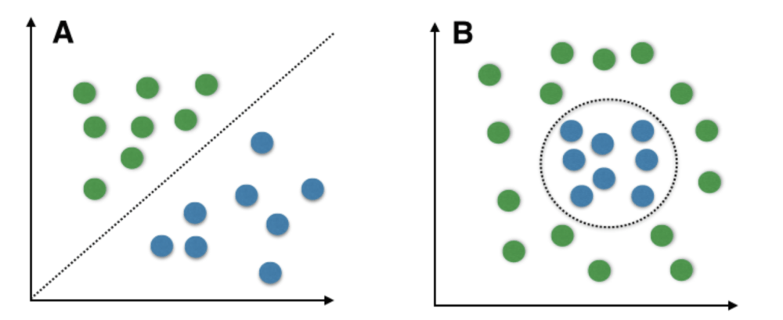
Linear SVM
Linear SVMs use a linear decision boundary to separate data points in different classes.
Effective when data can be precisely linearly separated

Slide 8
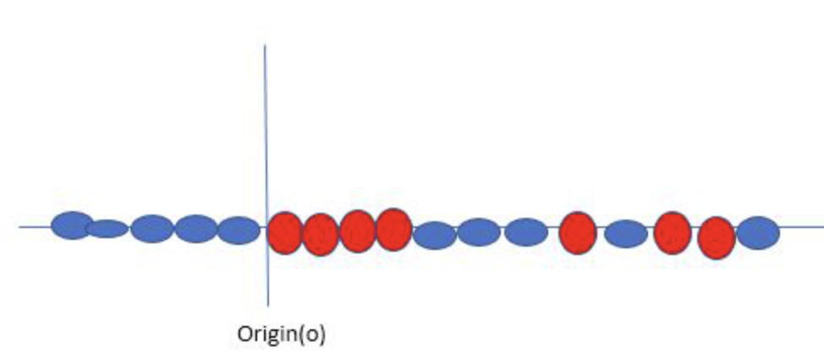
Non-Linear SVM
Non-linear SVMs can be used to classify data when it cannot be separated into two classes with a linear line. It does this by using kernel functions.

Slide 9
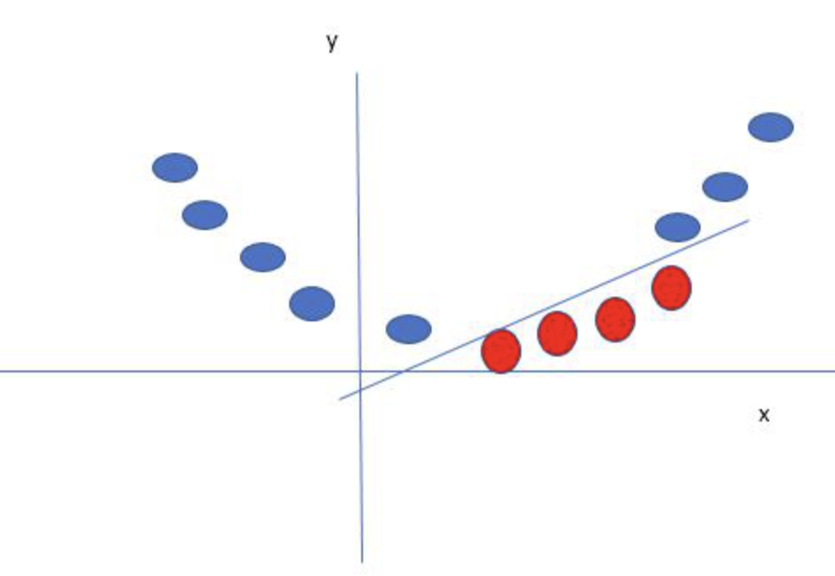
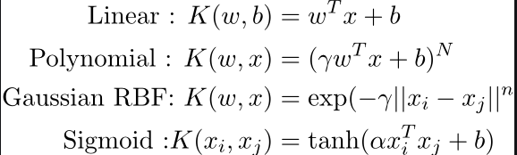
Kernel
Kernel is the mathematical function, which is used in SVM to map the original input data points into high-dimensional feature spaces, so that the hyperplane can be easily found out even if the data points are not linearly separable in the original input space

Slide 10
Pros and Cons
Pros:
Works relatively well when there is a clear margin of separation between classes
Effective in high dimensional spaces due to its different kernel functions
Memory efficient, as it uses a subset of training points in the decision function called support vectors
Cons:
Not suitable for large data sets
Cannot perform well when classes are not distinct
We do not get probability estimates with SVM

